Slide 1
Basal Ganglia - Brainstem - Cranial Nerves - Cerebellum

Slide 2
Learning outcomes
Explain the anatomical and physiological roles of the basal ganglia and cerebellum in motor control and coordination.
Describe the functional organization of the brainstem and its integration with ascending and descending pathways.
Identify the cranial nerves, outlining their nuclei, functional components, and clinical relevance.
Evaluate how dysfunctions in these structures manifest in clinical presentations such as Parkinsonism, ataxia, or cranial nerve palsies.

Slide 3
Interpreting tissue sections
Nuclei: collections of neurons more densely packed together, with similar functions and projections
Tracts: bundles of neuronal projections, often ascending or descending the CNS and connecting different levels
Commissure: bundles of neuronal projections connecting areas between brain hemispheres
Association fibres: bundles of neuronal projections connecting areas within the same hemisphere
Projecting fibres: bundles of fibers connecting the cortex to brainstem, spinal cord, and subcortical nuclei

Slide 4
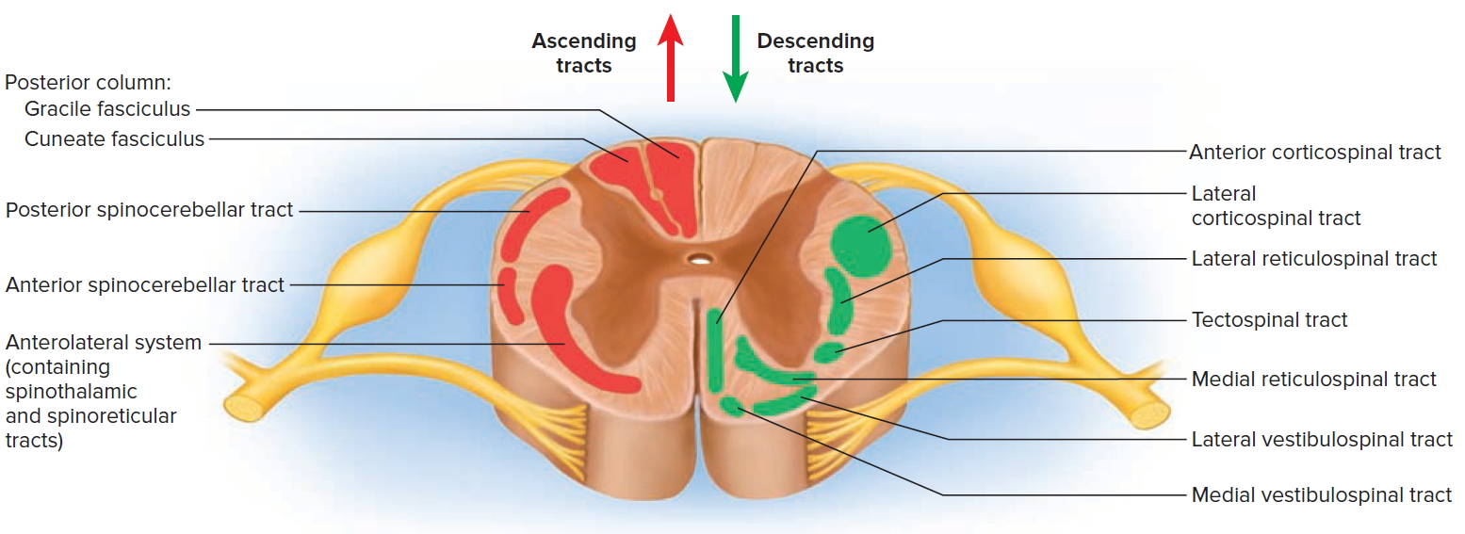
The spinal cord

Slide 5
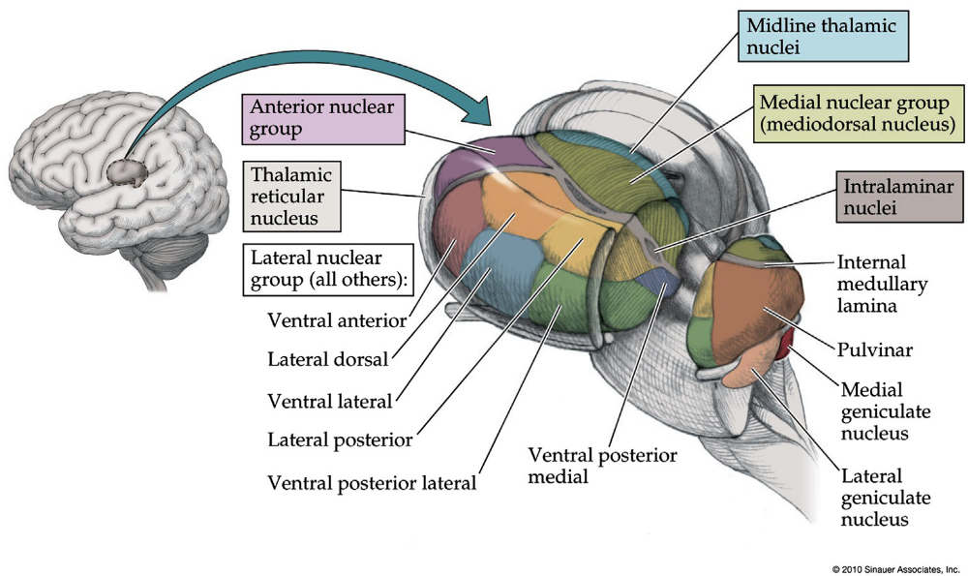
Anatomy: thalamus
The thalamus is part of the diencephalon
The thalamus is divided in several nuclei according to the inputs it receives
The ventrolateral and ventroanterior nuclei are related to motor information
  Between the external and internal medullary laminae
Posterior nuclei are associated with somatosensory information

Slide 6
The Brain
Area 3,1,2 - somatosensory cortex
Area 4 - primary motor cortex
Area 6 - supplementary motor area

Slide 7

Neuronal communication: the neurotransmitter
Main inhibitory
neurotransmitter
Main excitatory
neurotransmitter
https://www.compoundchem.com/2015/07/30/neurotransmitters/

Slide 8

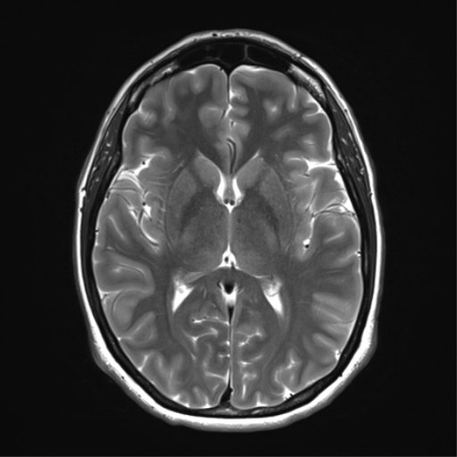
Basal ganglia

Slide 9
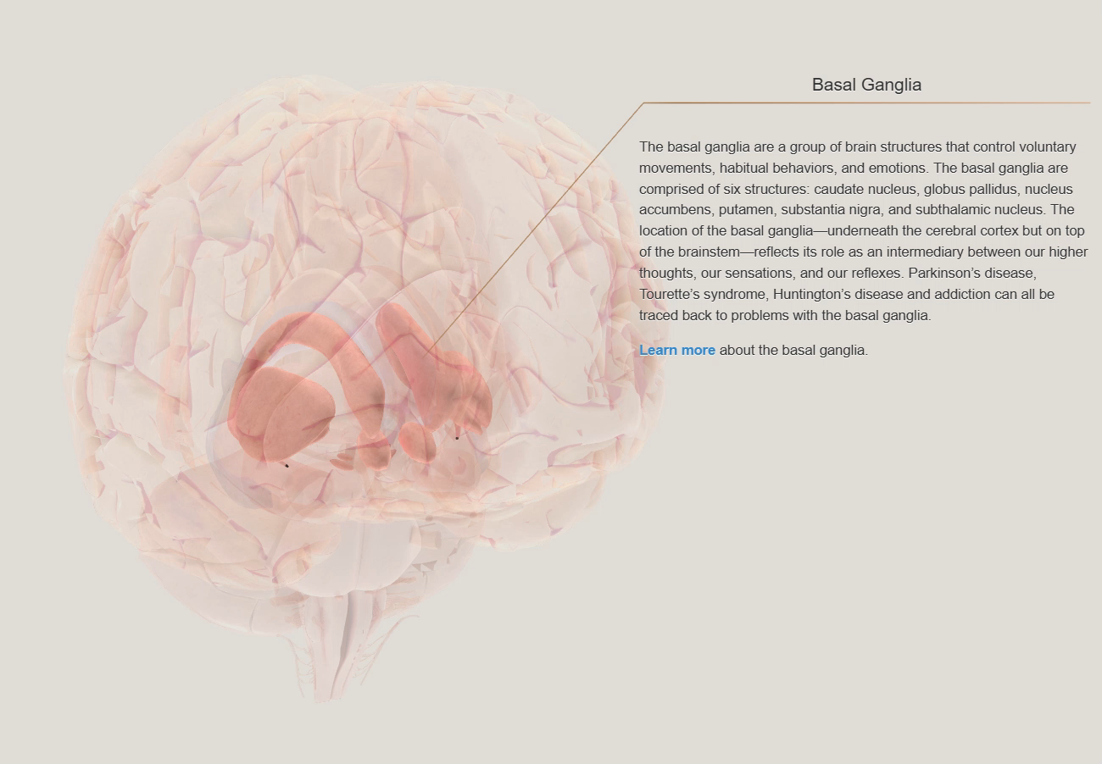
Basal Ganglia
The motor cortex is involved in the planning and direction of voluntary motor output
The cerebellum is responsible for integrating balance and other sensory components to produce complex motor activity
The basal ganglia act to initiate and maintain the proper speed and smoothness of motor activity.
Control complex patterns of motor activity
  Writing, using scissors, hammering nails, most aspects of vocalization, controlled movement of the eyes
https://www.brainfacts.org/3d-brain#intro=false&focus=Brain-basal_ganglia

Slide 10
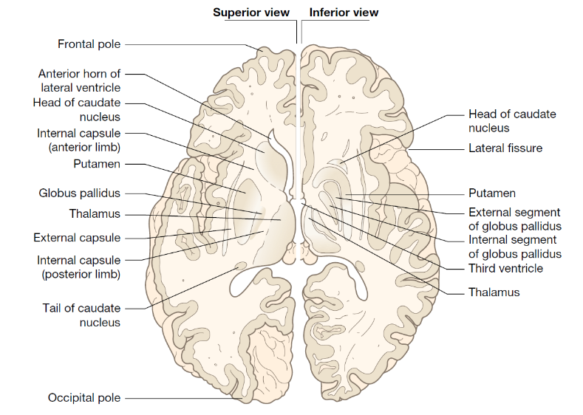
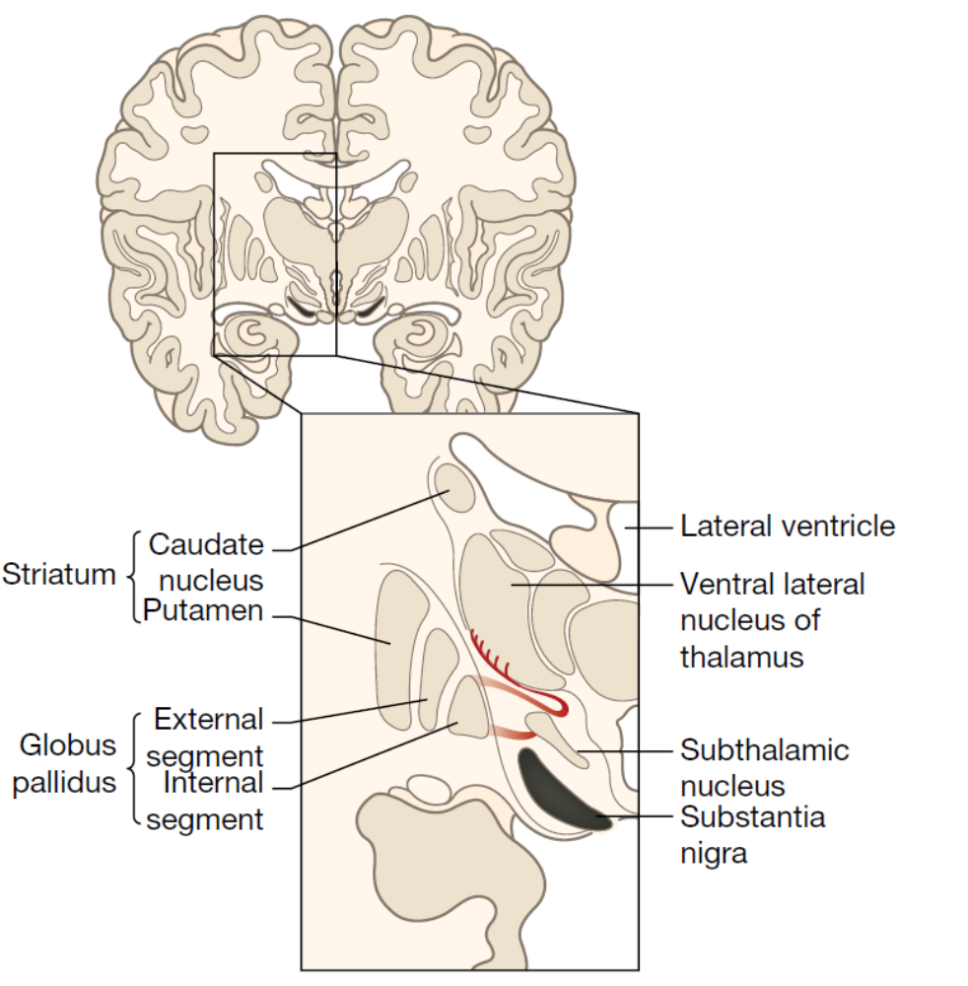
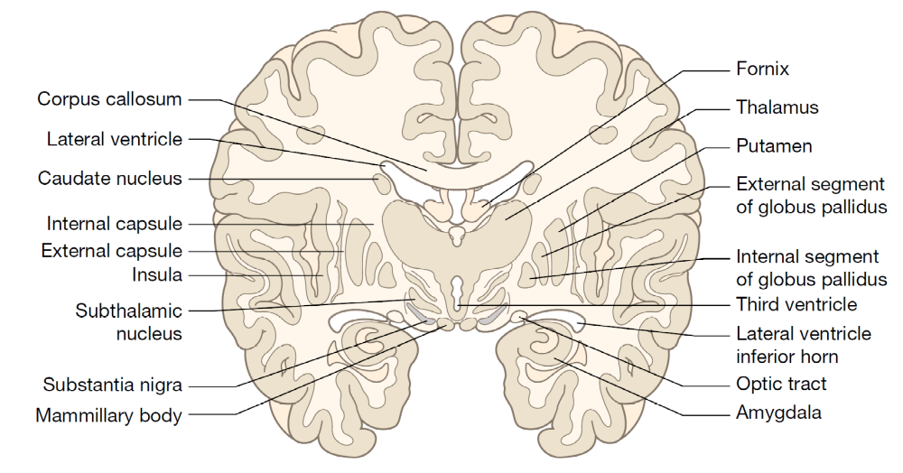
Anatomy

Slide 11
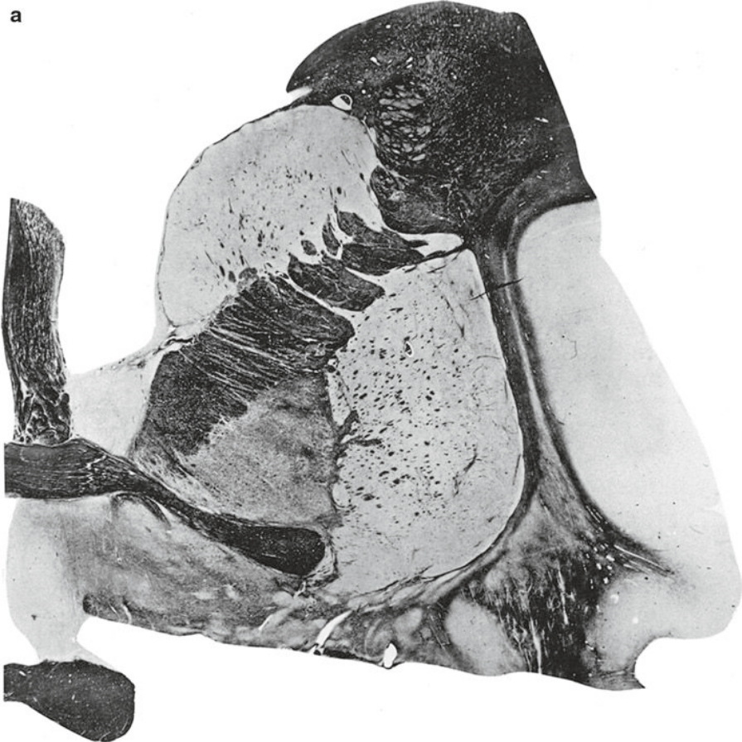
Anatomy
Striatum
  Caudate
  Putamen
Globus Pallidus (GP)
  Internal (GPi)
  External (GPe)
Substantia Nigra (SN)
  Pars compacta (SNc)
  Pars reticulata (SNr)
Subthalamic Nucleus (STN)
Caudate
Globus
Pallidus
Putamen

Slide 12
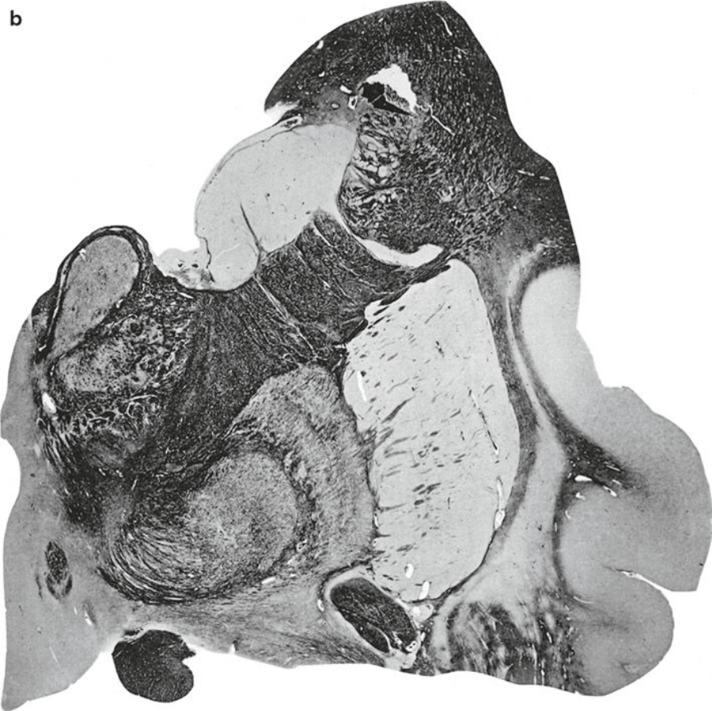
Anatomy
Striatum
  Caudate
  Putamen
Globus Pallidus (GP)
  Internal (GPi)
  External (GPe)
Substantia Nigra (SN)
  Pars compacta (SNc)
  Pars reticulata (SNr)
Subthalamic Nucleus (STN)
Caudate
Thalamus
Globus Pallidus
Interior + Exterior
Putamen

Slide 13
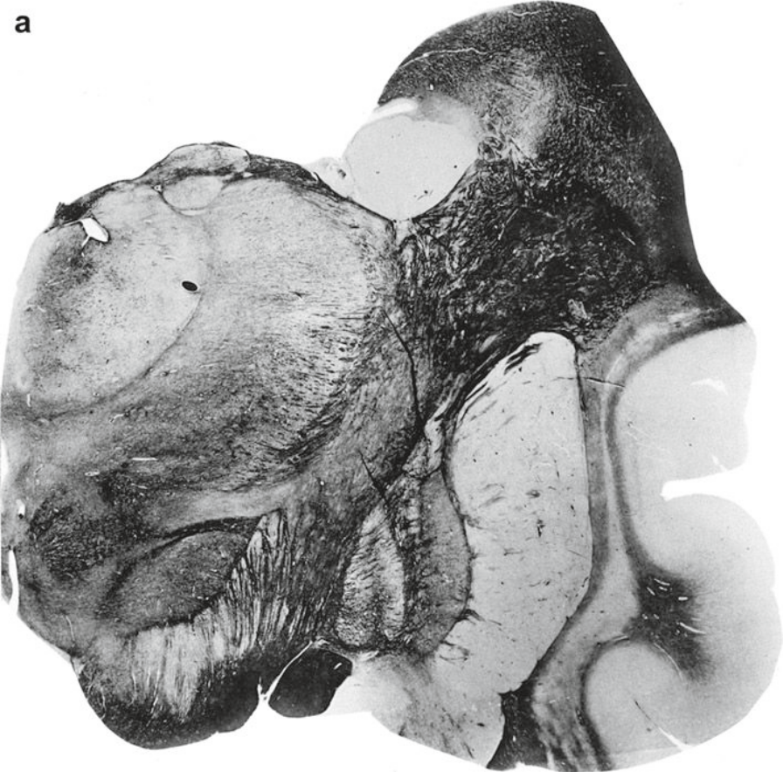
Anatomy
Caudate
Striatum
  Caudate
  Putamen
Globus Pallidus (GP)
  Internal (GPi)
  External (GPe)
Substantia Nigra (SN)
  Pars compacta (SNc)
  Pars reticulata (SNr)
Subthalamic Nucleus (STN)
Thalamus
Subthalamic
Nucleus
Globus Pallidus
Interior + Exterior
Putamen

Slide 14
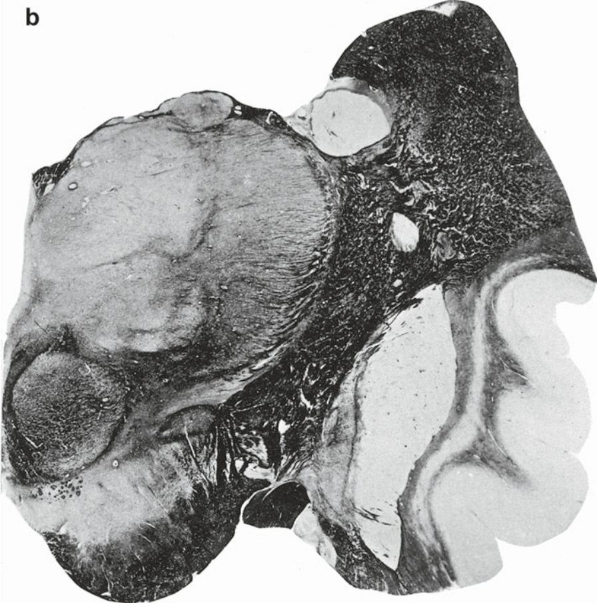
Anatomy
Caudate
Striatum
  Caudate
  Putamen
Globus Pallidus (GP)
  Internal (GPi)
  External (GPe)
Substantia Nigra (SN)
  Pars compacta (SNc)
  Pars reticulata (SNr)
Subthalamic Nucleus (STN)
Thalamus
Substantia
Nigra
Subthalamic
Nucleus
Putamen
Globus Pallidus
Interior + Exterior

Slide 15
Neuronal communication: the neurotransmitter
https://www.compoundchem.com/2015/07/30/neurotransmitters/

Slide 16
Neuronal communication: the neurotransmitter
Modulatory
neurotransmitter
https://www.compoundchem.com/2015/07/30/neurotransmitters/

Slide 17
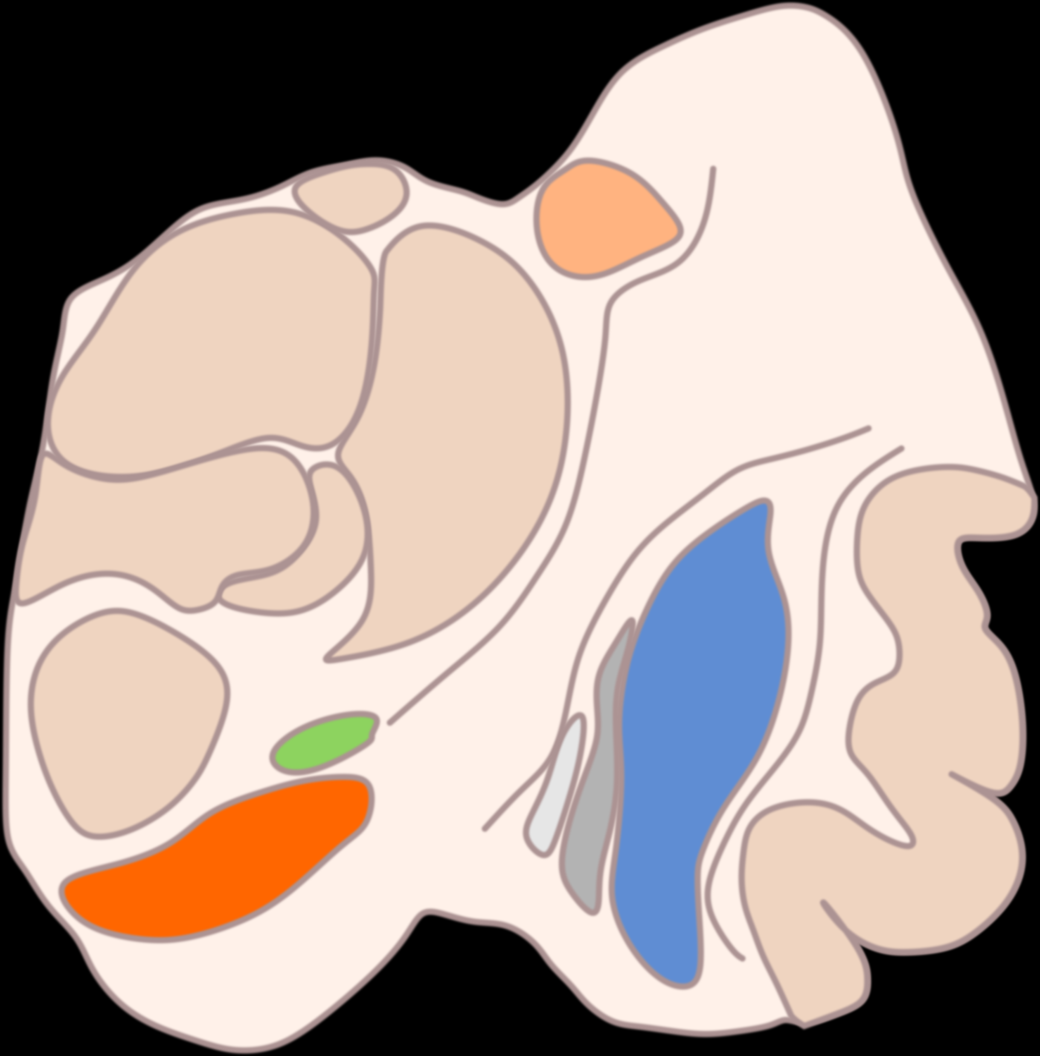
Basal ganglia: Input/output
Cortex
Cortex afferent (layer V) are predominantly excitatory (glutamate)
Primary motor, premotor, supplementary motor and somatosensory cortices project mainly to the putamen
Prefrontal cortex and many other associative areas project to the caudate
The information processed by the basal ganglia returns to the cortex (mainly supplementary motor area, but also somatosensory and motor) through the thalamus (ventroanterior and ventrolateral nuclei)
Caudate
Thalamus (VA & VL)
Subthalamic
Nucleus
Substantia
Nigra
GPi
GPe
Putamen

Slide 18
Basal ganglia: Intrinsic connections
Cortex
Direct pathway
  Striatum (Inhibitory) → GPi/SNr
  GPi/SNr (Inhibitory) → VA and VL Thalamus
  VA/VL Thalamus (Excitatory) → Cortex (prefrontal, premotor and SMA)
Caudate
Thalamus (VA & VL)
Subthalamic
Nucleus
Substantia
Nigra
GPi
GPe
Putamen

Slide 19
Basal ganglia: Intrinsic connections
Cortex
Direct pathway
  Striatum (Inhibitory) → GPi/SNr
  GPi/SNr (Inhibitory) → VA and VL Thalamus
  VA/VL Thalamus (Excitatory) → Cortex (prefrontal, premotor and SMA)
Indirect pathway
  Striatum (Inhibitory) → GPe
  GPe (Inhibitory) → STN
  STN (Excitatory) → GPi/SNr
  GPi/SNr (Inhibitory) → VL Thalamus
  VL Thalamus (Excitatory) → Cortex
Caudate
Thalamus (VA & VL)
Subthalamic
Nucleus
Substantia
Nigra
GPi
GPe
Putamen

Slide 20
Corticostriato-pallido-thalamocortical loop
Direct pathway → Promotion of movement
  Stimulation of the striatum by the cortex leads to disinhibition of the thalamus
  Striatum inhibits GPi/SNr → thalamic activation
Indirect pathway → suppression of movement
  Stimulation of the striatum by the cortex inhibits the GPe
  GPe no longer inhibits the STN which can stimulate GPi/SNr → thalamic inhibition
STN also receives direct projection from the cortex
  Hyperdirect pathway
Cortex
Striatum
Thalamus
GPe
STN
GPi/SNr

Slide 21
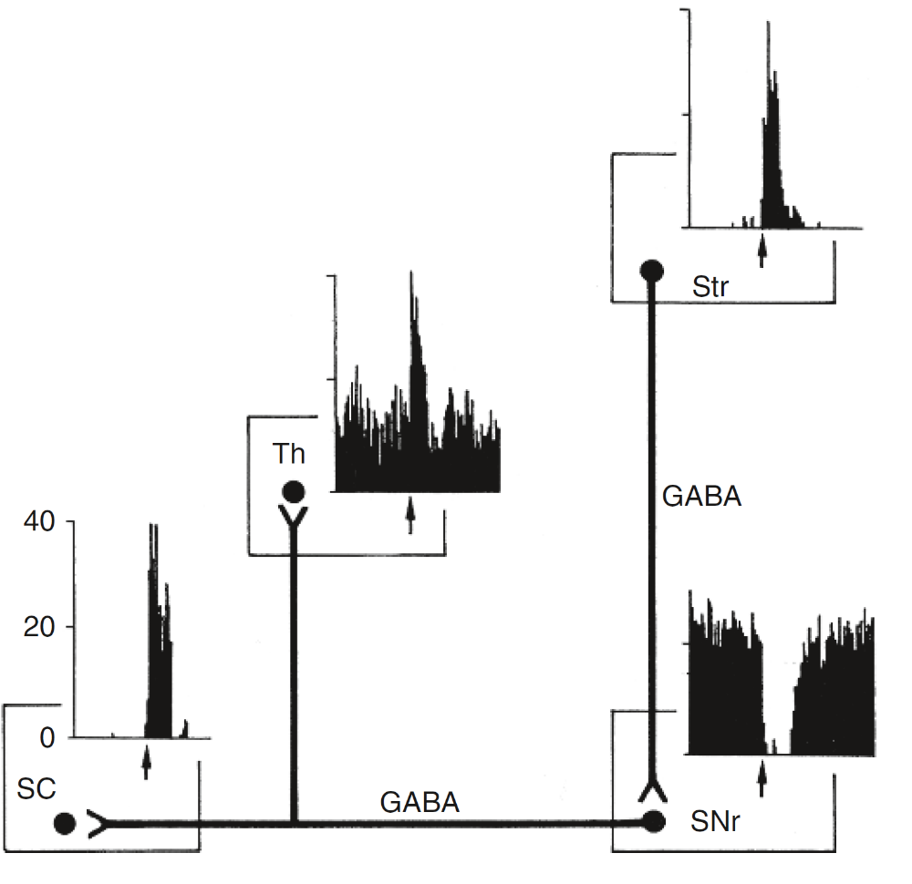
Corticostriato-pallido-thalamocortical loop
Direct pathway → Promotion of movement
  Stimulation of the striatum by the cortex leads to disinhibition of the thalamus
  Striatum inhibits GPi/SNr → thalamic activation
Indirect pathway → suppression of movement
  Stimulation of the striatum by the cortex inhibits the GPe
  GPe no longer inhibits the STN which can stimulate GPi/SNr → thalamic inhibition
STN also receives direct projection from the cortex
  Hyperdirect pathway
Many nuclei have tonic firing that get inhibited/modulated

Slide 22
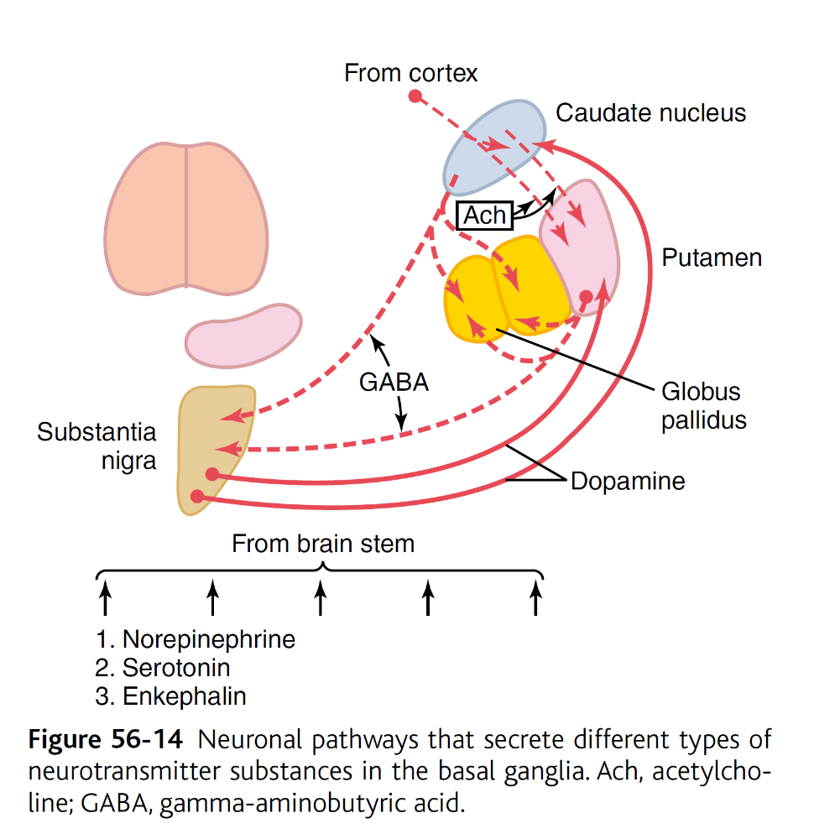
Neuromodulation within the basal ganglia
Dopamine projections from the SNc to caudate/putamen
Acetylcholine projections from the cortex to caudate/putamen
Multiple modulating neurotransmitters mainly from the brainstem
  Norepinephrine
  Serotonin
  Enkephalin

Slide 23
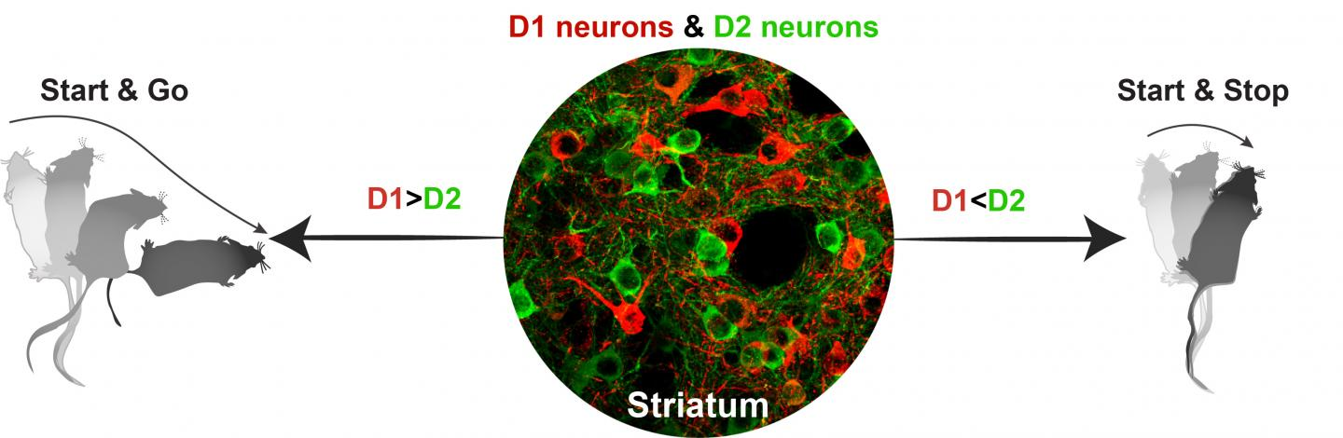
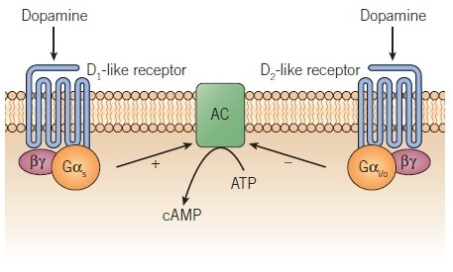
Neuromodulation within the basal ganglia: dopamine
Striatal neurons can be divided into two groups, according to their dopamine receptors:
  D1 neurons - express D1 type dopamine receptors
  D2 neurons - express D2 type dopamine receptors
An Overview of Dopamine Receptor Pharmacology (news-medical.net)
Image: NIEHS

Slide 24
Neuromodulation within the basal ganglia: dopamine
Striatal neurons can be divided into two groups, according to their dopamine receptors:
  D1 neurons - express D1 type dopamine receptors
  D2 neurons - express D2 type dopamine receptors
D1 neurons mostly belong to the direct pathway
  Release of dopamine supports strong phasic inputs from D1 neurons → Facilitated direct pathway
  D1 type dopamine receptors are activating GPCRs (Gs)
D2 neurons mostly belong to the indirect pathway
  Release of dopamine suppresses the firing of D2 neurons → Reduced impact from the indirect pathway
  D2 type dopamine receptors are inhibiting GPCRs (Gi)
Cortex
D2
D1
-
+
Striatum
Thalamus
GPe
STN
GPi/SNr
SNc

Slide 25
Neuromodulation within the basal ganglia: dopamine
Dopamine facilitates movement stimulating the direct pathway and inhibiting the indirect pathway!
Image: NIEHS

Slide 26
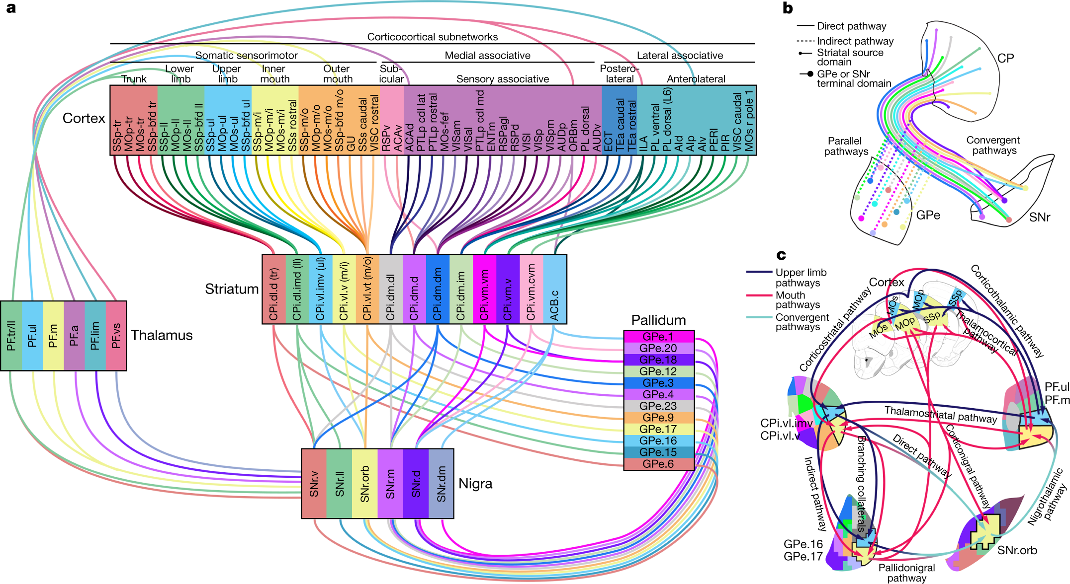
Multiple parallel pathways
Nat Neurosci. 2016 Aug;19(8):1100-14

Slide 27
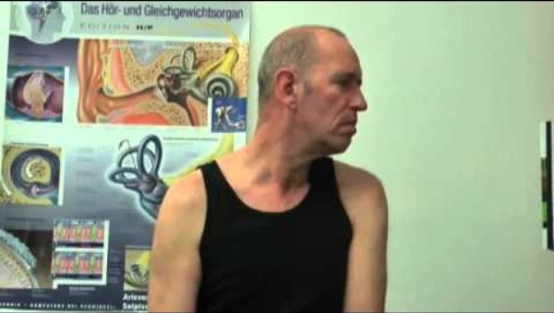
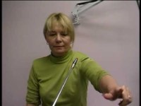

Lesions of the basal ganglia
Lesions of the caudate
  Rarely motor disturbances, mostly behavioural
  Abulia - apathy with loss of initiative and of spontaneous thought and emotional responses
Lesions of putamen/globus pallidus
  Dystonia - muscle contraction and spasms
  Athetosis - writhing movements of hand, arm and neck
Lesion of the subthalamic nucleus
  Hemiballismus - Flailing movement of a limb

Slide 28
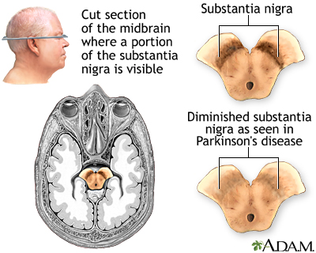
Parkinson’s disease
Degeneration of the substantia nigra pars compacta
Substantia
Nigra

Slide 29
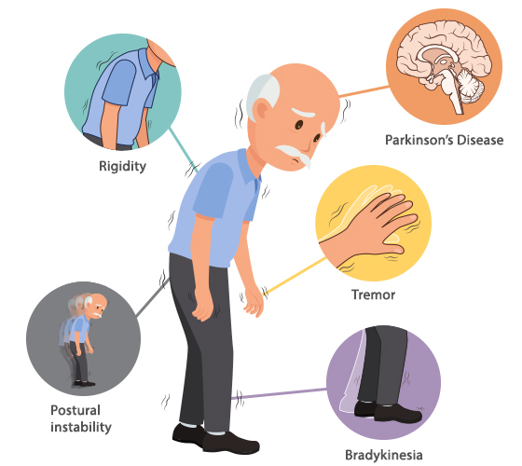
Parkinson’s disease
Motor
  Muscle rigidity
  Involuntary tremor, moving or resting, at 3-6 cycles/sec
  Akinesia - difficulty in movement initiation
  Bradykinesia: Slowness in executing movements
  Postural instability, with poor balance and falls - impaired postural reflexes
  Dysphagia (impaired swallowing)
  Gait disturbance
Non-motor
  Speech disorder
  Fatigue
  REM sleep disorder
  Autonomic dysfunction
  Cognitive decline
  Pain

Slide 30
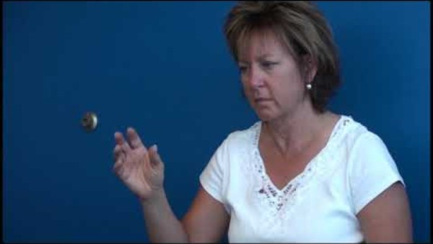
Parkinson’s disease

Slide 31
Parkinson’s disease: unclear etiology
Mostly late onset with sporadic cases
Genetics
  10% of cases are familiar (mutations in PARK1-10 genes)
  PARK-1 gene for α-synuclein → higher in PD
  LRRK2 gene
Environmental
  Chemicals like MPTP (1-methyl-4phenyl-1,2,5,6,-
  tetrahydropyridine) can induce PD
  Agrochemicals (pesticides)?
  Gut microbiome? (α-synuclein aggregates found in the gut)

Slide 32
Parkinson’s disease: mechanism
Destruction of SN dopaminergic neurons will remove inhibition on the indirect pathway
  Direct pathway becomes underactive
  Indirect pathway becomes overactive
Some feedback circuits based on acetylcholine could be the cause of the oscillations which cause the tremor.
Akinesia might also be connected to the lack of mental drive due to decrease dopamine secretion in the accumbens (another basal ganglia nucleus mostly related to emotions and reward).
Cortex
D2
D1
-
+
Striatum
Thalamus
GPe
STN
GPi/SNr
SNc

Slide 33
Parkinson’s disease: mechanism
Destruction of SN dopaminergic neurons will remove inhibition on the indirect pathway
  Direct pathway becomes underactive
  Indirect pathway becomes overactive
Some feedback circuits based on acetylcholine could be the cause of the oscillations which cause the tremor.
Akinesia might also be connected to the lack of mental drive due to decrease dopamine secretion in the accumbens (another basal ganglia nucleus mostly related to emotions and reward).
Cortex
D2
D1
Striatum
Thalamus
GPe
STN
GPi/SNr
SNc

Slide 34
Treatment
L-DOPA
  Converted in the brain into dopamine (dopamine itself doesn’t pass the BBB)
  Ameliorates many symptoms, especially rigidity and akinesia.
  Chronic L-DOPA can lead to on-off effects (motor fluctuations) or levodopa-induced dyskinesia (excessive movement)
Amantadine
  Partial dopamine agonist
  Decrease dopamine reuptake
  Antiglutammatergic and anticholinergic properties
L-DOPA and Amantadine often given together

Slide 35
Treatment
DOPA decarboxylase inhibitors → Increasing the levels of DOPA
  Carbidopa or benserazide
MAOs and COMT inhibitors
  Reduced dopamine degradation
  Reduced degradation of DOPA (COMT inhibitors)
  Reduces the degeneration of dopaminergic neurons in the SN (unexplained)
Anticholinergic drugs (benzhexol, benzatropine)
  Loss of DA dis-inhibits striatal cholinergic interneurons
Inoculation of fetal ESC or iPSC-derived dopaminergic neurons (clinical trials)
Physical activity and physiotherapy

Slide 36
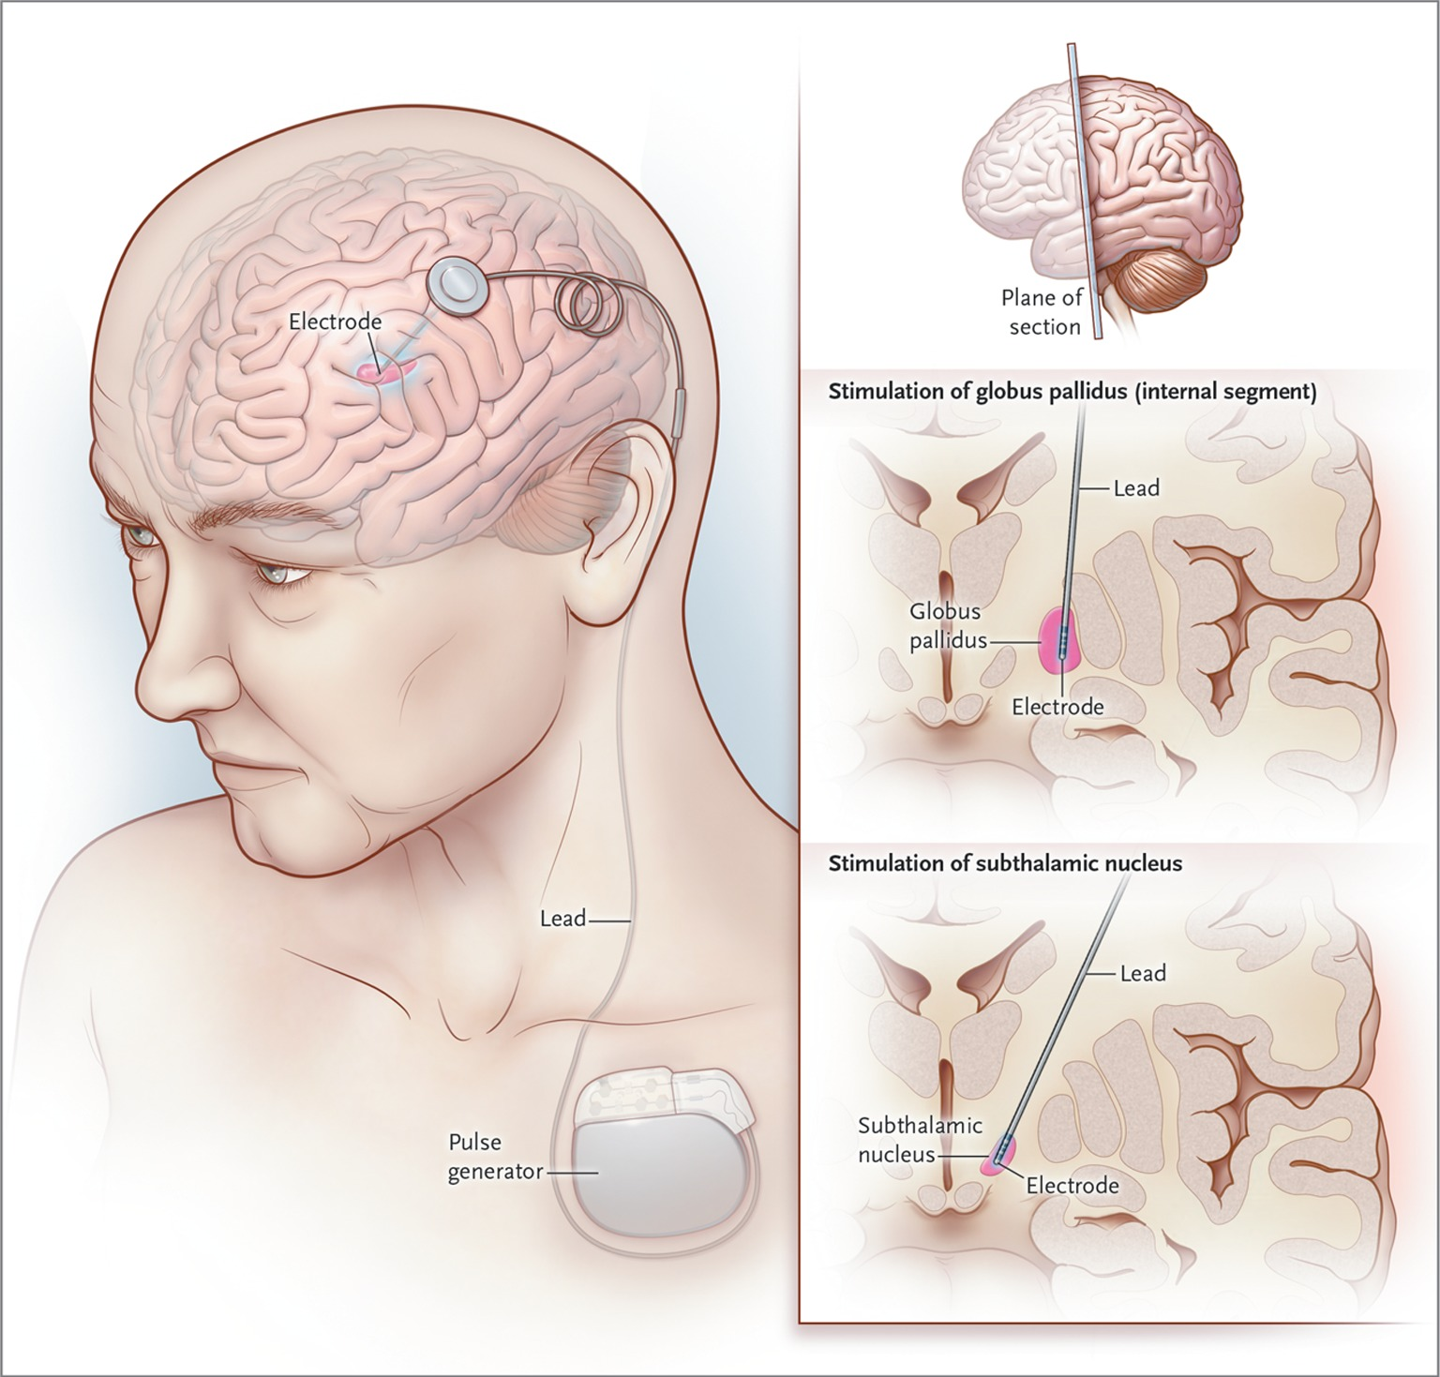
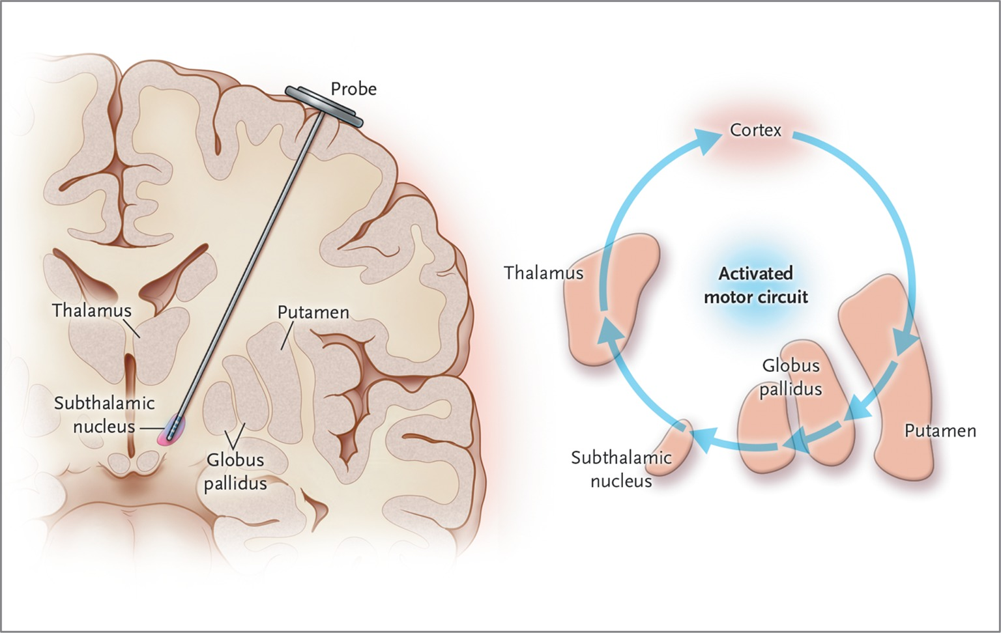
Treatment
Deep brain stimulation of STN or GPi
  Patients nonresponsive to drugs
  Reduces rigidity, tremors and bradykinesia
N Engl J Med 2012;367:1529-38

Slide 37
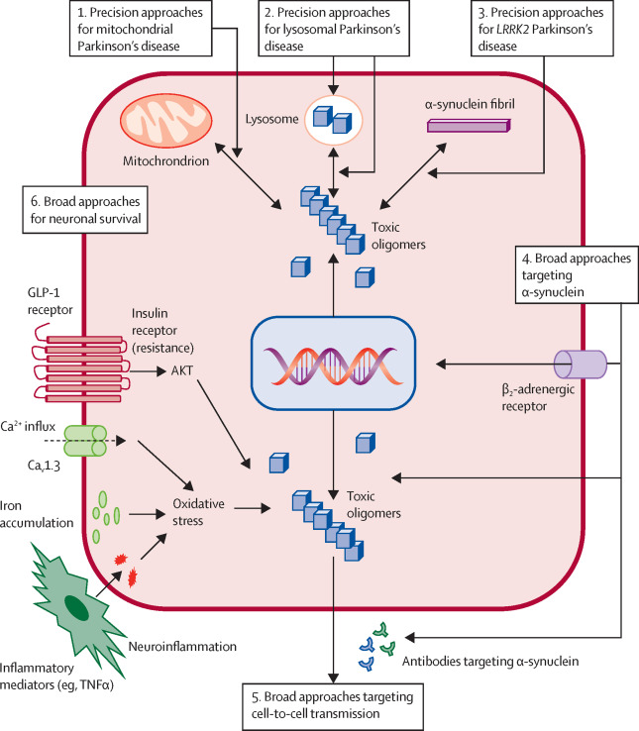
Failings in current therapies
Not all symptoms addressed
  Postural balance unaffected
Side effects can be severe
  L-DOPA-induced dyskinesia
  Amantadine can give nausea, psychotic episodes, restless legs, convulsion
Do not address the degeneration of neurons
  Urgent need of neuroprotective approaches
  Lots of research going on!
Lancet Neurology 2021 Jul;20(7):559-572

Slide 38
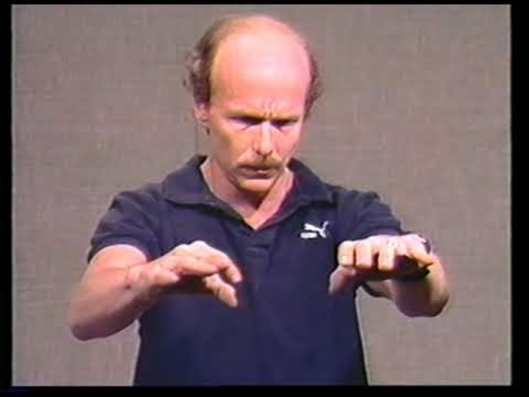
Huntington’s Disease (Chorea)
Onset 30-40 years - inherited
Flicking movements that worsen into severe distortional movements of the entire body
  Followed by severe dementia
Loss of GABAergic neurons in caudate and putamen
  Early stages only indirect pathway D2 striatal neurons
  Loss of inhibition on SN and GP causing outbursts
  Later stages interest many other areas of the brain, including the cortex
Mutation in the gene of huntingtin causes multiple codon repeats (CAG) of the amino acid glutamine → poly-glutamine disease
  Over 35 CAG repeats
  Degradation causes macromolecular aggregates
  Various mechanisms of neurotoxicity involved

Slide 39
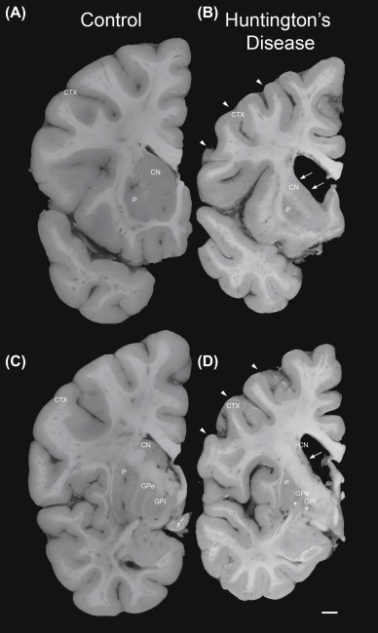
Huntington’s Disease (Chorea)
Onset 30-40 years - inherited
Flicking movements that worsen into severe distortional movements of the entire body
  Followed by sever dementia
Loss of GABAergic neurons in caudate and putamen
  Early stages only indirect pathway D2 striatal neurons
  Loss of inhibition on SN and GP causing outbursts
  Later stages interest many other areas of the brain, including the cortex
Mutation in the gene of huntingtin causes multiple codon repeats (CAG) of the amino acid glutamine → poly-glutamine disease
  Over 35 CAG repeats
  Degradation causes macromolecular aggregates
  Various mechanisms of neurotoxicity involved

Slide 40
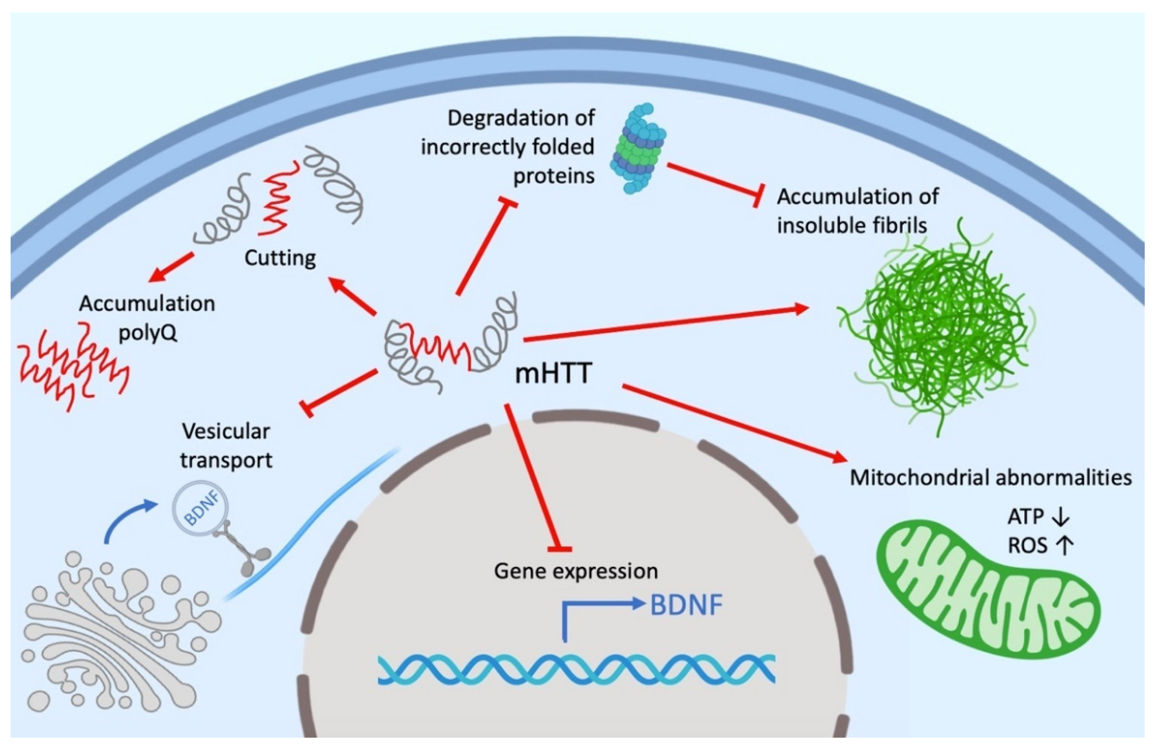
Huntington’s Disease (Chorea)
Onset 30-40 years - inherited
Flicking movements that worsen into severe distortional movements of the entire body
  Followed by sever dementia
Loss of GABAergic neurons in caudate and putamen
  Early stages only indirect pathway D2 striatal neurons
  Loss of inhibition on SN and GP causing outbursts
  Later stages interest many other areas of the brain, including the cortex
Mutation in the gene of huntingtin causes multiple codon repeats (CAG) of the amino acid glutamine → poly-glutamine disease
  Over 35 CAG repeats
  Degradation causes macromolecular aggregates
  Various mechanisms of neurotoxicity involved
Int. J. Mol. Sci. 2022, 23(24), 15533; https://doi.org/10.3390/ijms232415533

Slide 41
Huntington’s Disease (Chorea)
Onset 30-40 years - inherited
Flicking movements that worsen into severe distortional movements of the entire body
  Followed by sever dementia
Loss of GABAergic neurons in caudate and putamen
  Early stages only indirect pathway D2 striatal neurons
  Loss of inhibition on SN and GP causing outbursts
  Later stages interest many other areas of the brain, including the cortex
Mutation in the gene of huntingtin causes multiple codon repeats (CAG) of the amino acid glutamine → poly-glutamine disease
  Over 35 CAG repeats
  Degradation causes macromolecular aggregates
  Various mechanisms of neurotoxicity involved
Cortex
Striatum
Thalamus
GPe
STN
GPi/SNr

Slide 42

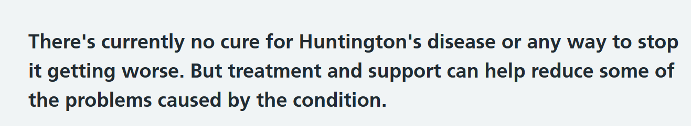
Huntington’s Disease (Chorea): treatment
Inhibitors of the vesicular monoamine 2 transporter
  Aim at depleting dopamine vesicles
  Tetrabenazine
  Neuropsychiatric adverse events
Emerging experimental therapies (preclinical)
  Lowering mutated huntingtin levels
  Inhibition of huntingtin aggregation
  Promotion of huntingtin clearance
  hMSCs
  Neurostimulation
“Despite the extraordinary growth of our knowledge about the cellular mechanisms involved in HD-related neurodegeneration, no effective neuroprotective or disease-modifying therapy has emerged”
Neurotherapeuthics Vol. 5, 181–197

Slide 43
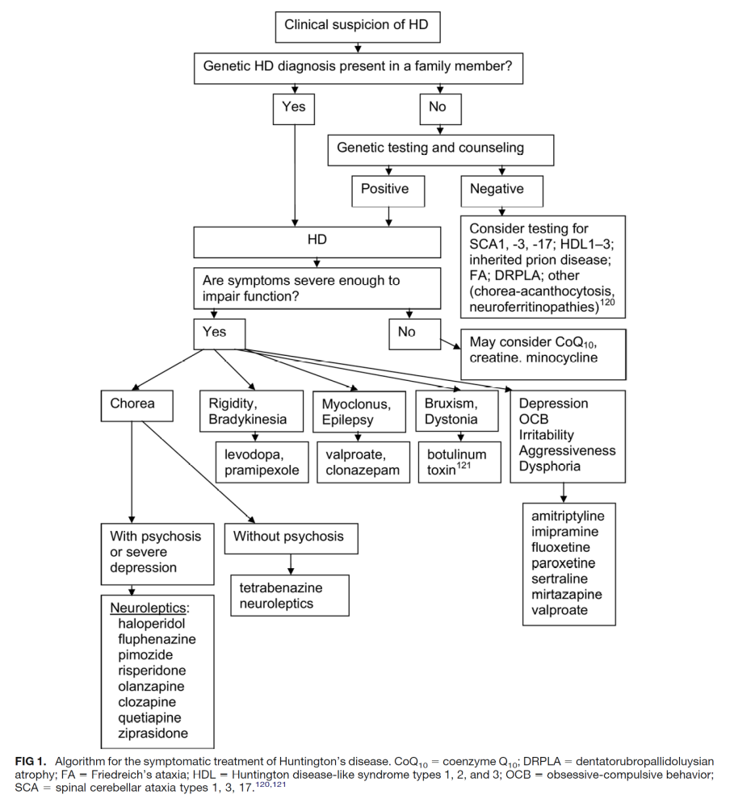
Huntington’s Disease (Chorea): treatment
Inhibitors of the vesicular monoamine 2 transporter
  Aim at depleting dopamine vesicles
  Tetrabenazine
  Neuropsychiatric adverse events
Emerging experimental therapies
  Lowering mutated huntingtin levels
  Inhibition of huntingtin aggregation
  Promotion of huntingtin clearance
  hMSCs
  Neurostimulation
Neurotherapeutics Vol. 5, 181–197

Slide 44
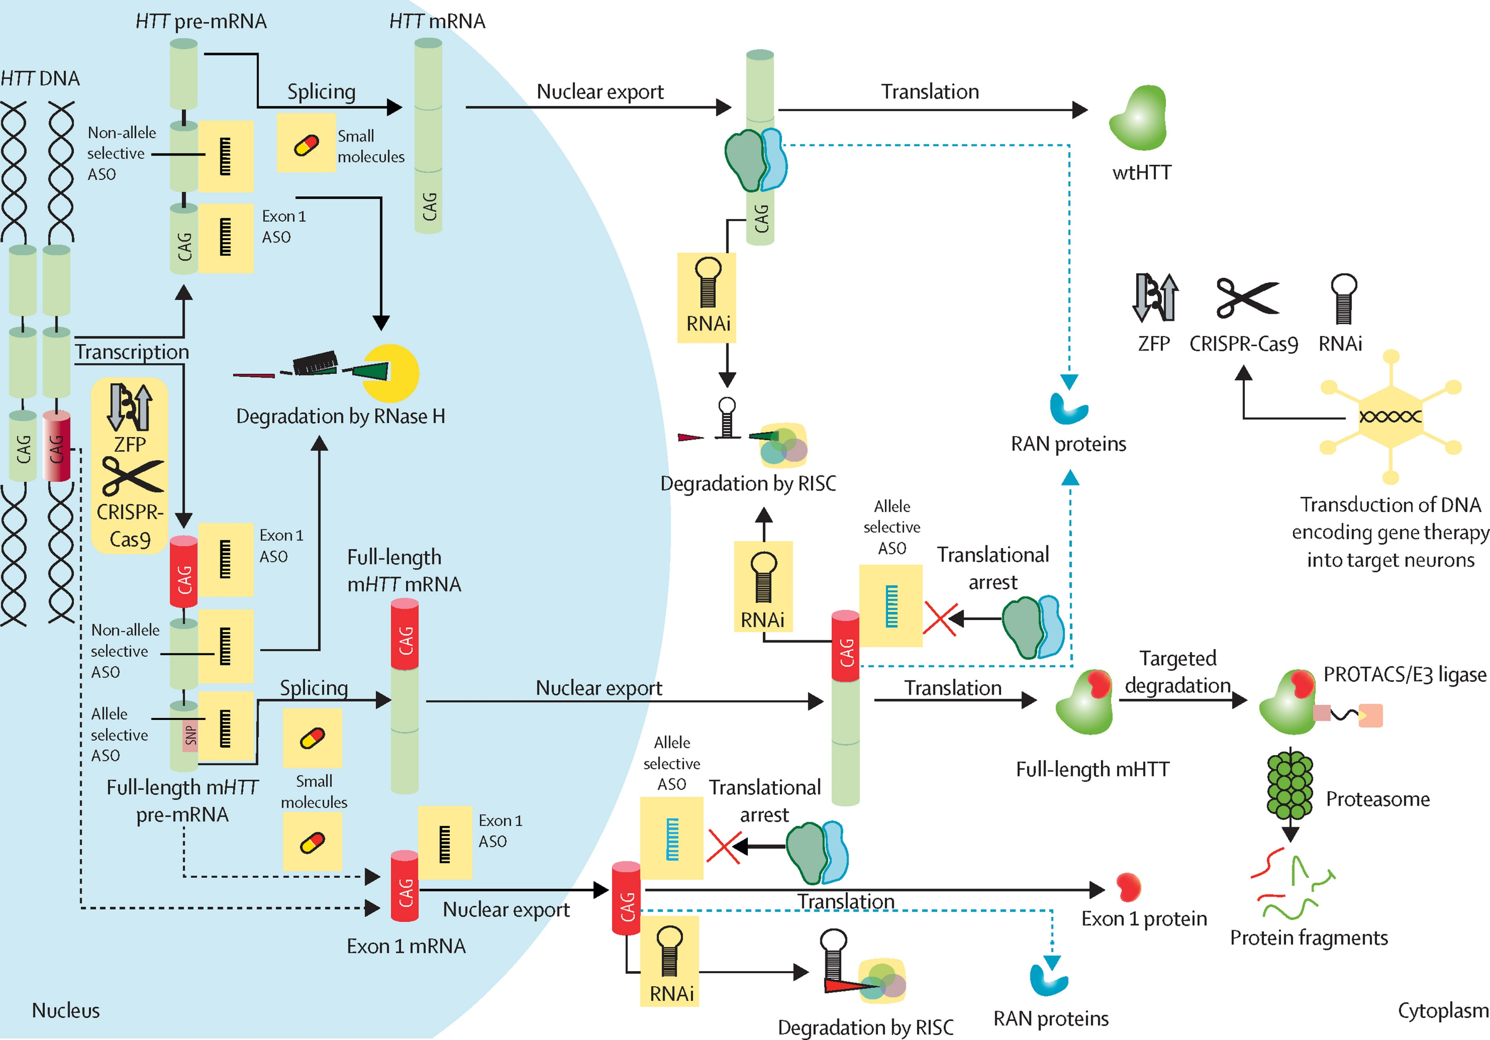
Huntington’s Disease (Chorea): treatment
Inhibitors of the vesicular monoamine 2 transporter
  Aim at depleting dopamine vesicles
  Tetrabenazine
  Neuropsychiatric adverse events
Emerging experimental therapies
  Mutated huntingtin-lowering
  Inhibition of huntingtin aggregation
  Promotion of huntingtin clearance
  hMSCs
  Neurostimulation
The Lancet Neurology Volume 21, Issue 7, July 2022, Pages 645-658

Slide 45
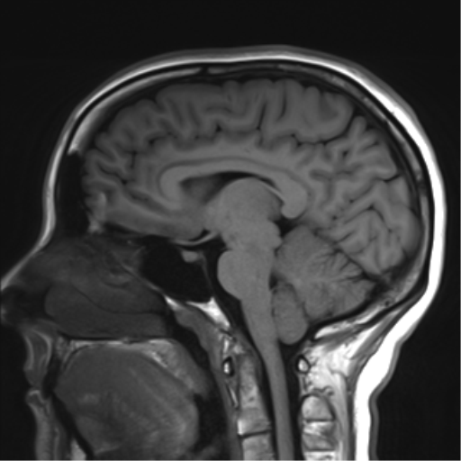
Brainstem and cranial nerves

Slide 46
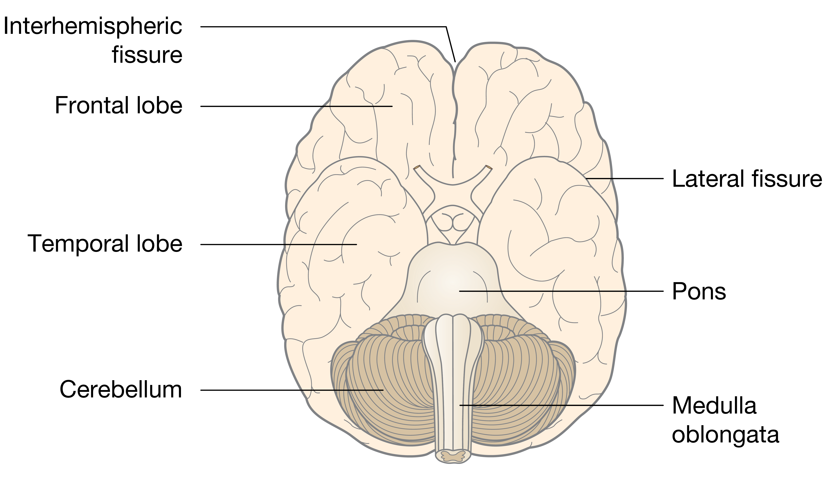
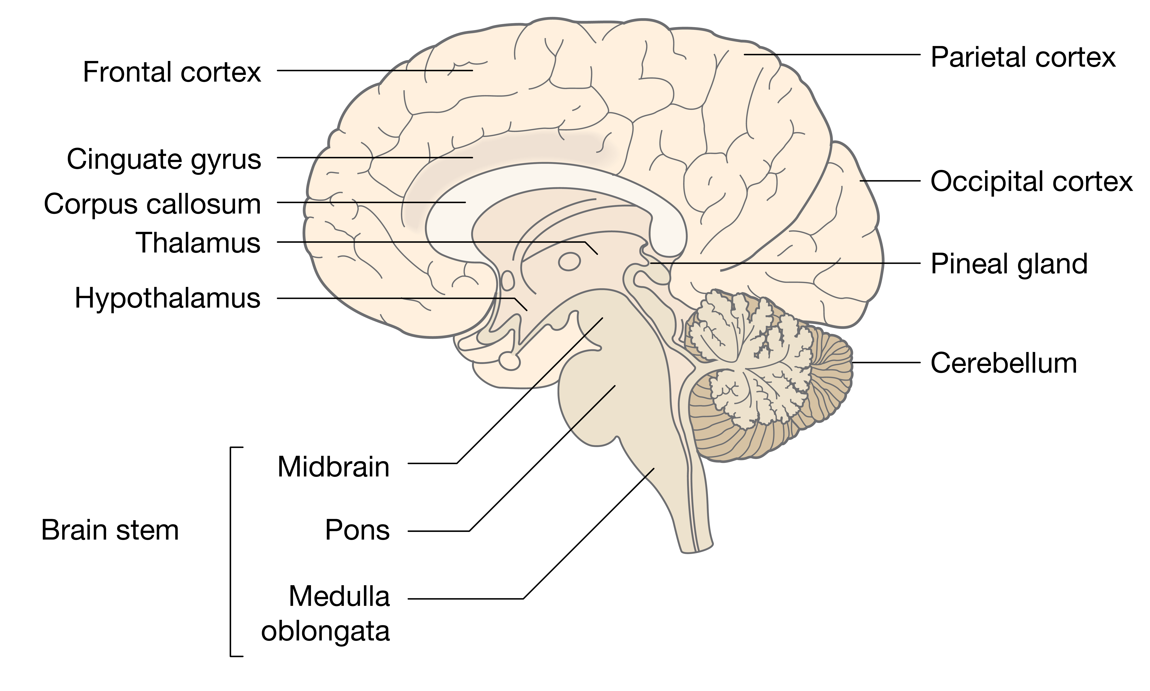
The CNS - Brain
Brainstem
Midbrain
Pons
Medulla Oblungata

Slide 47
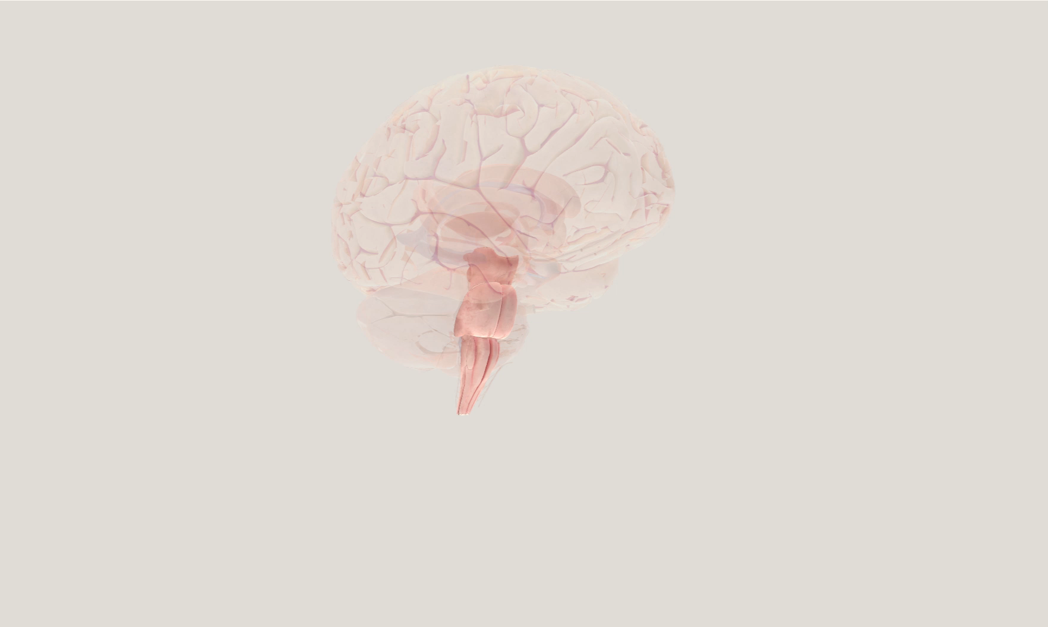
The brainstem

Slide 48
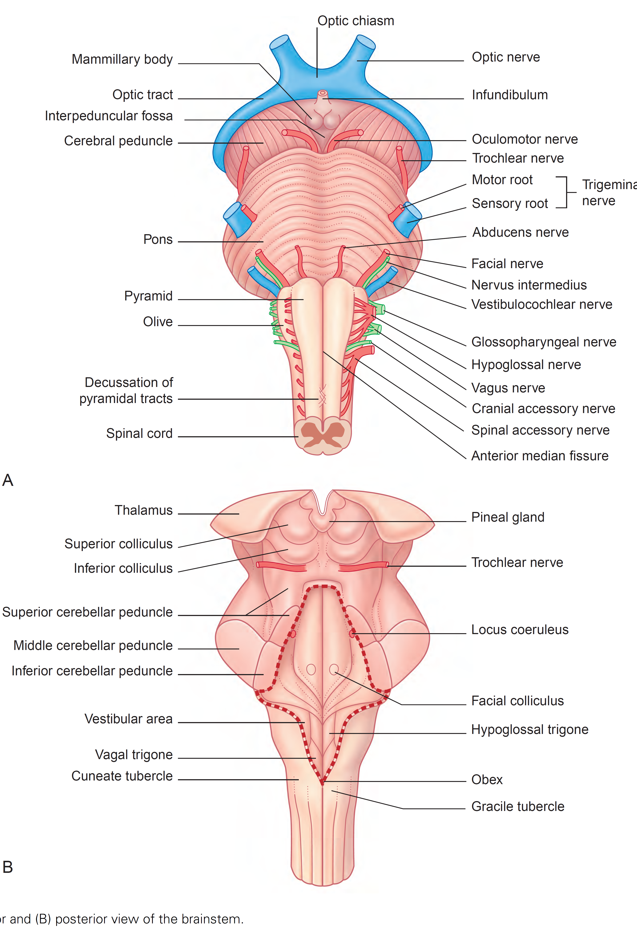
The brainstem

Slide 49
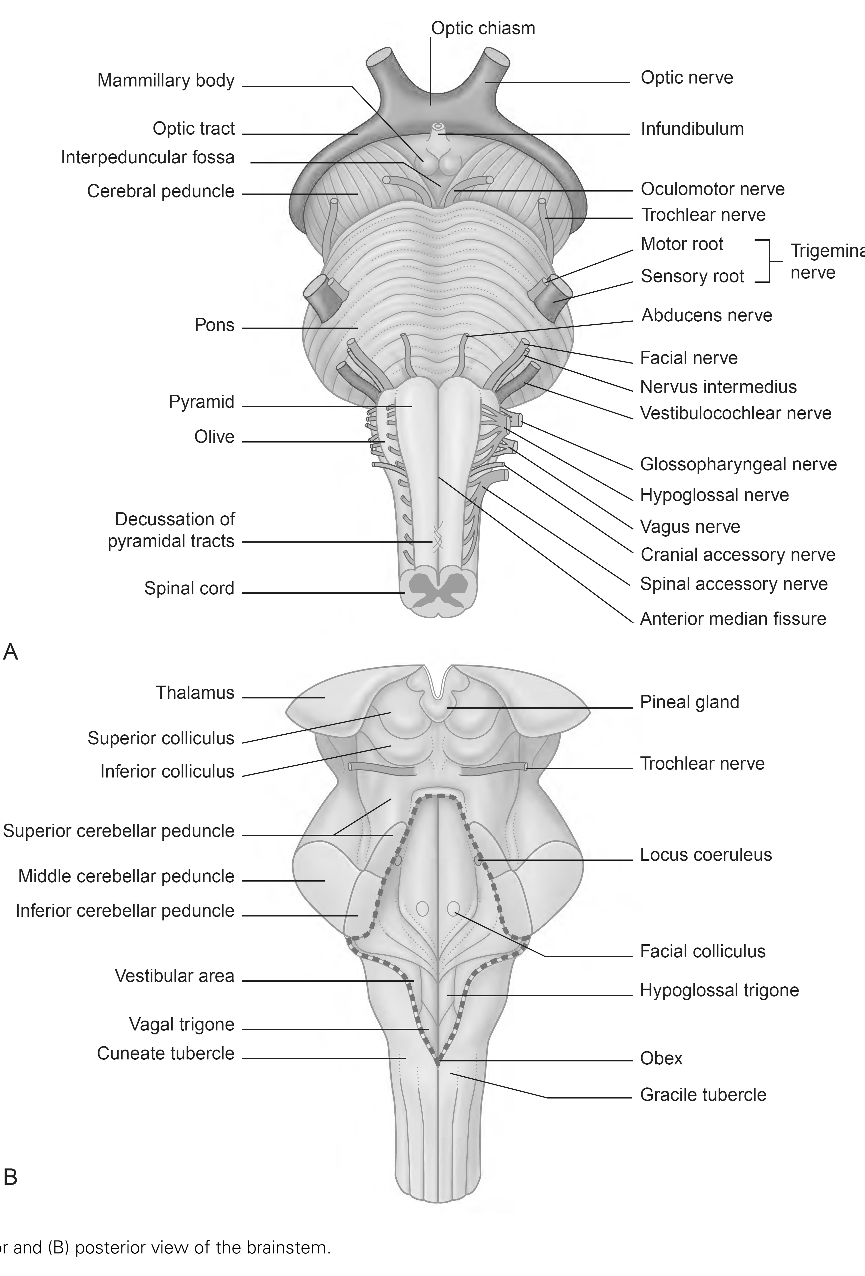
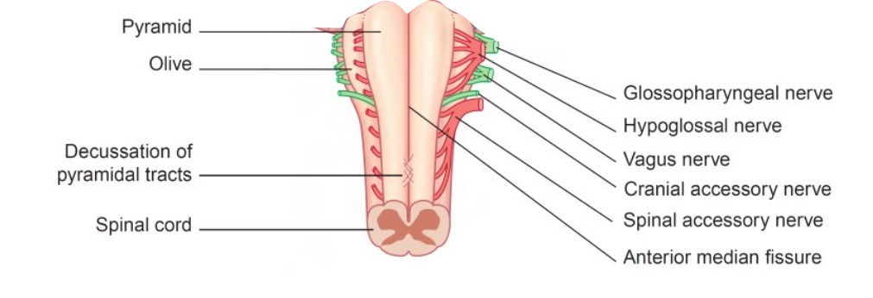
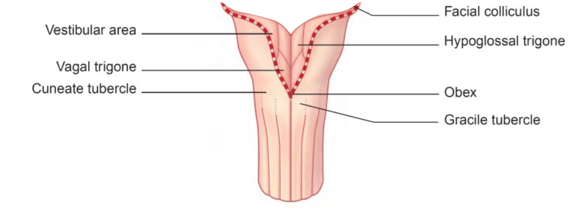
The medulla oblungata

Slide 50
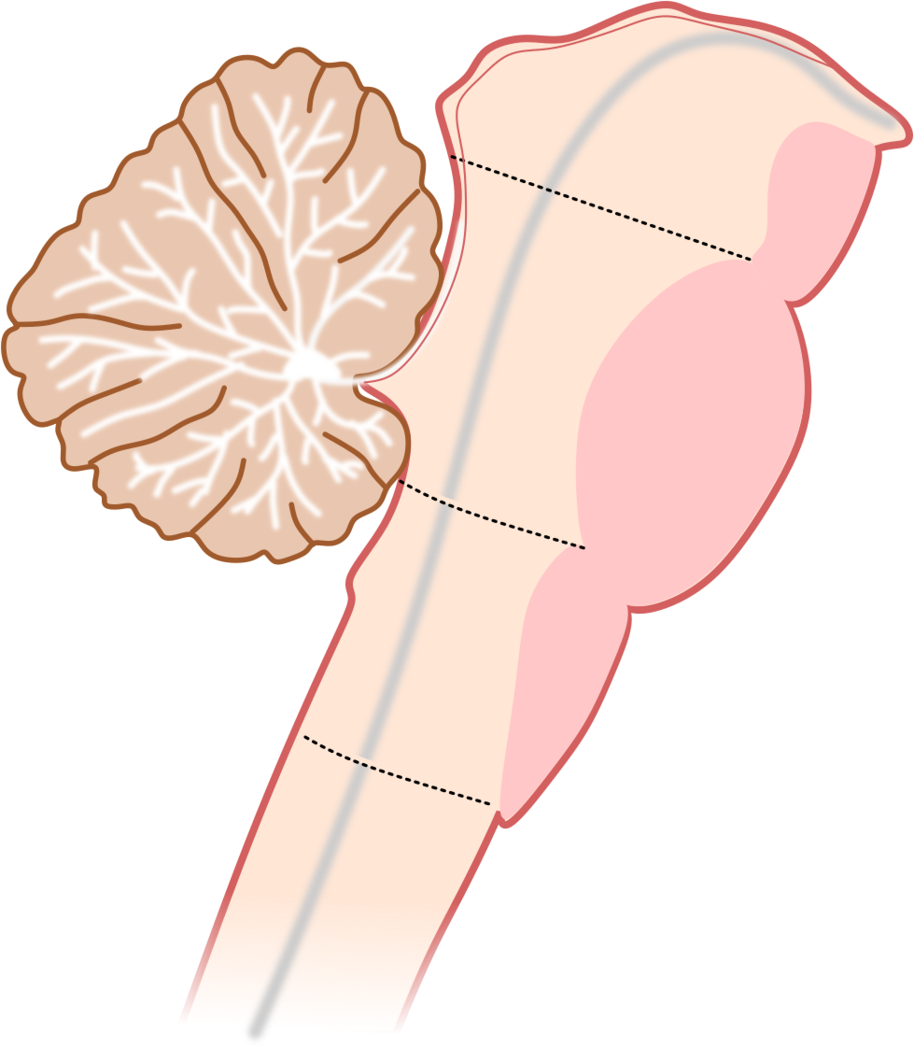
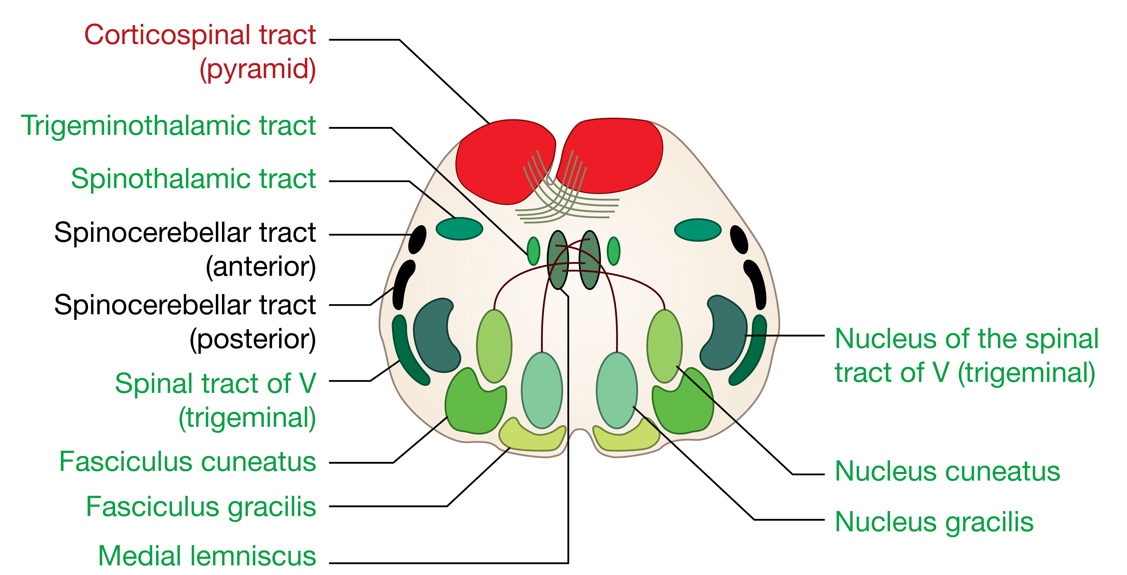
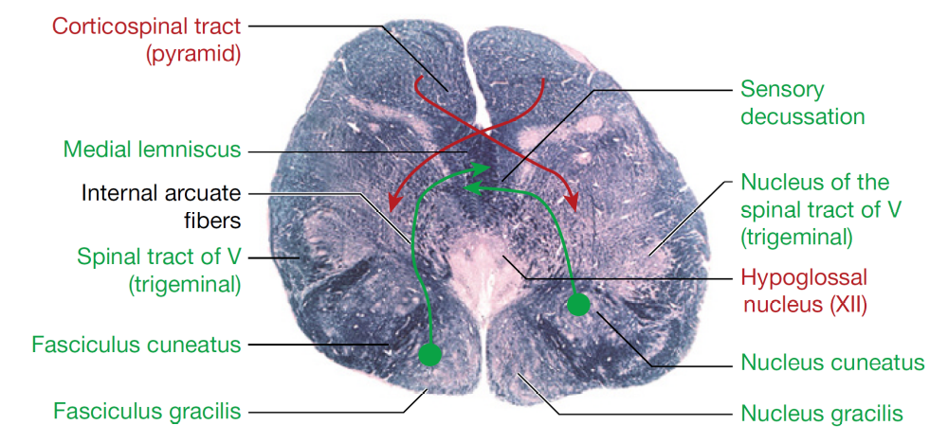
The medulla oblungata
Midbrain
Pons
Medulla
Oblungata
Sensory
Motor

Slide 51
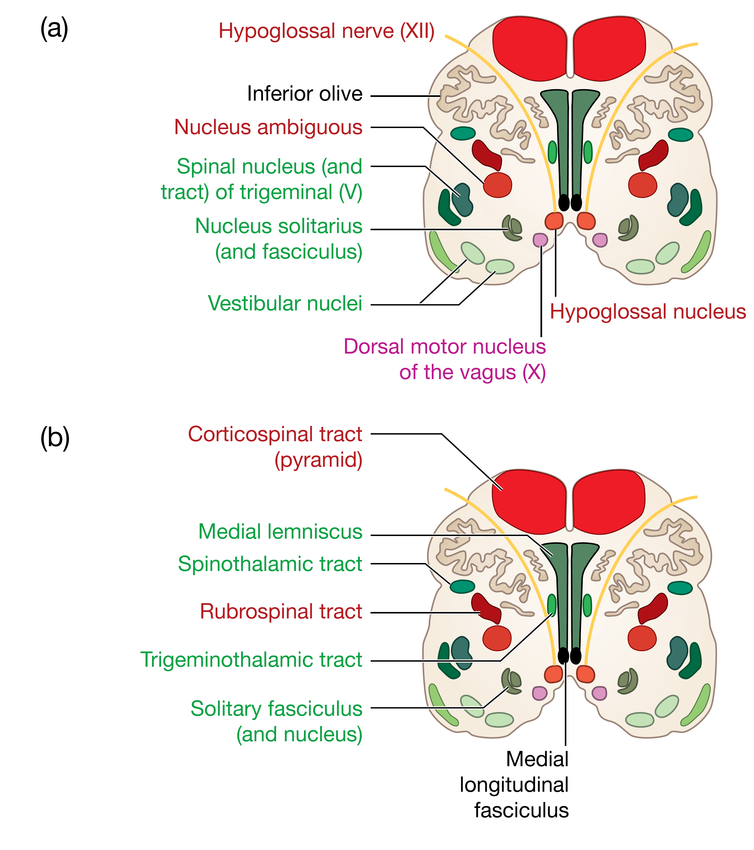
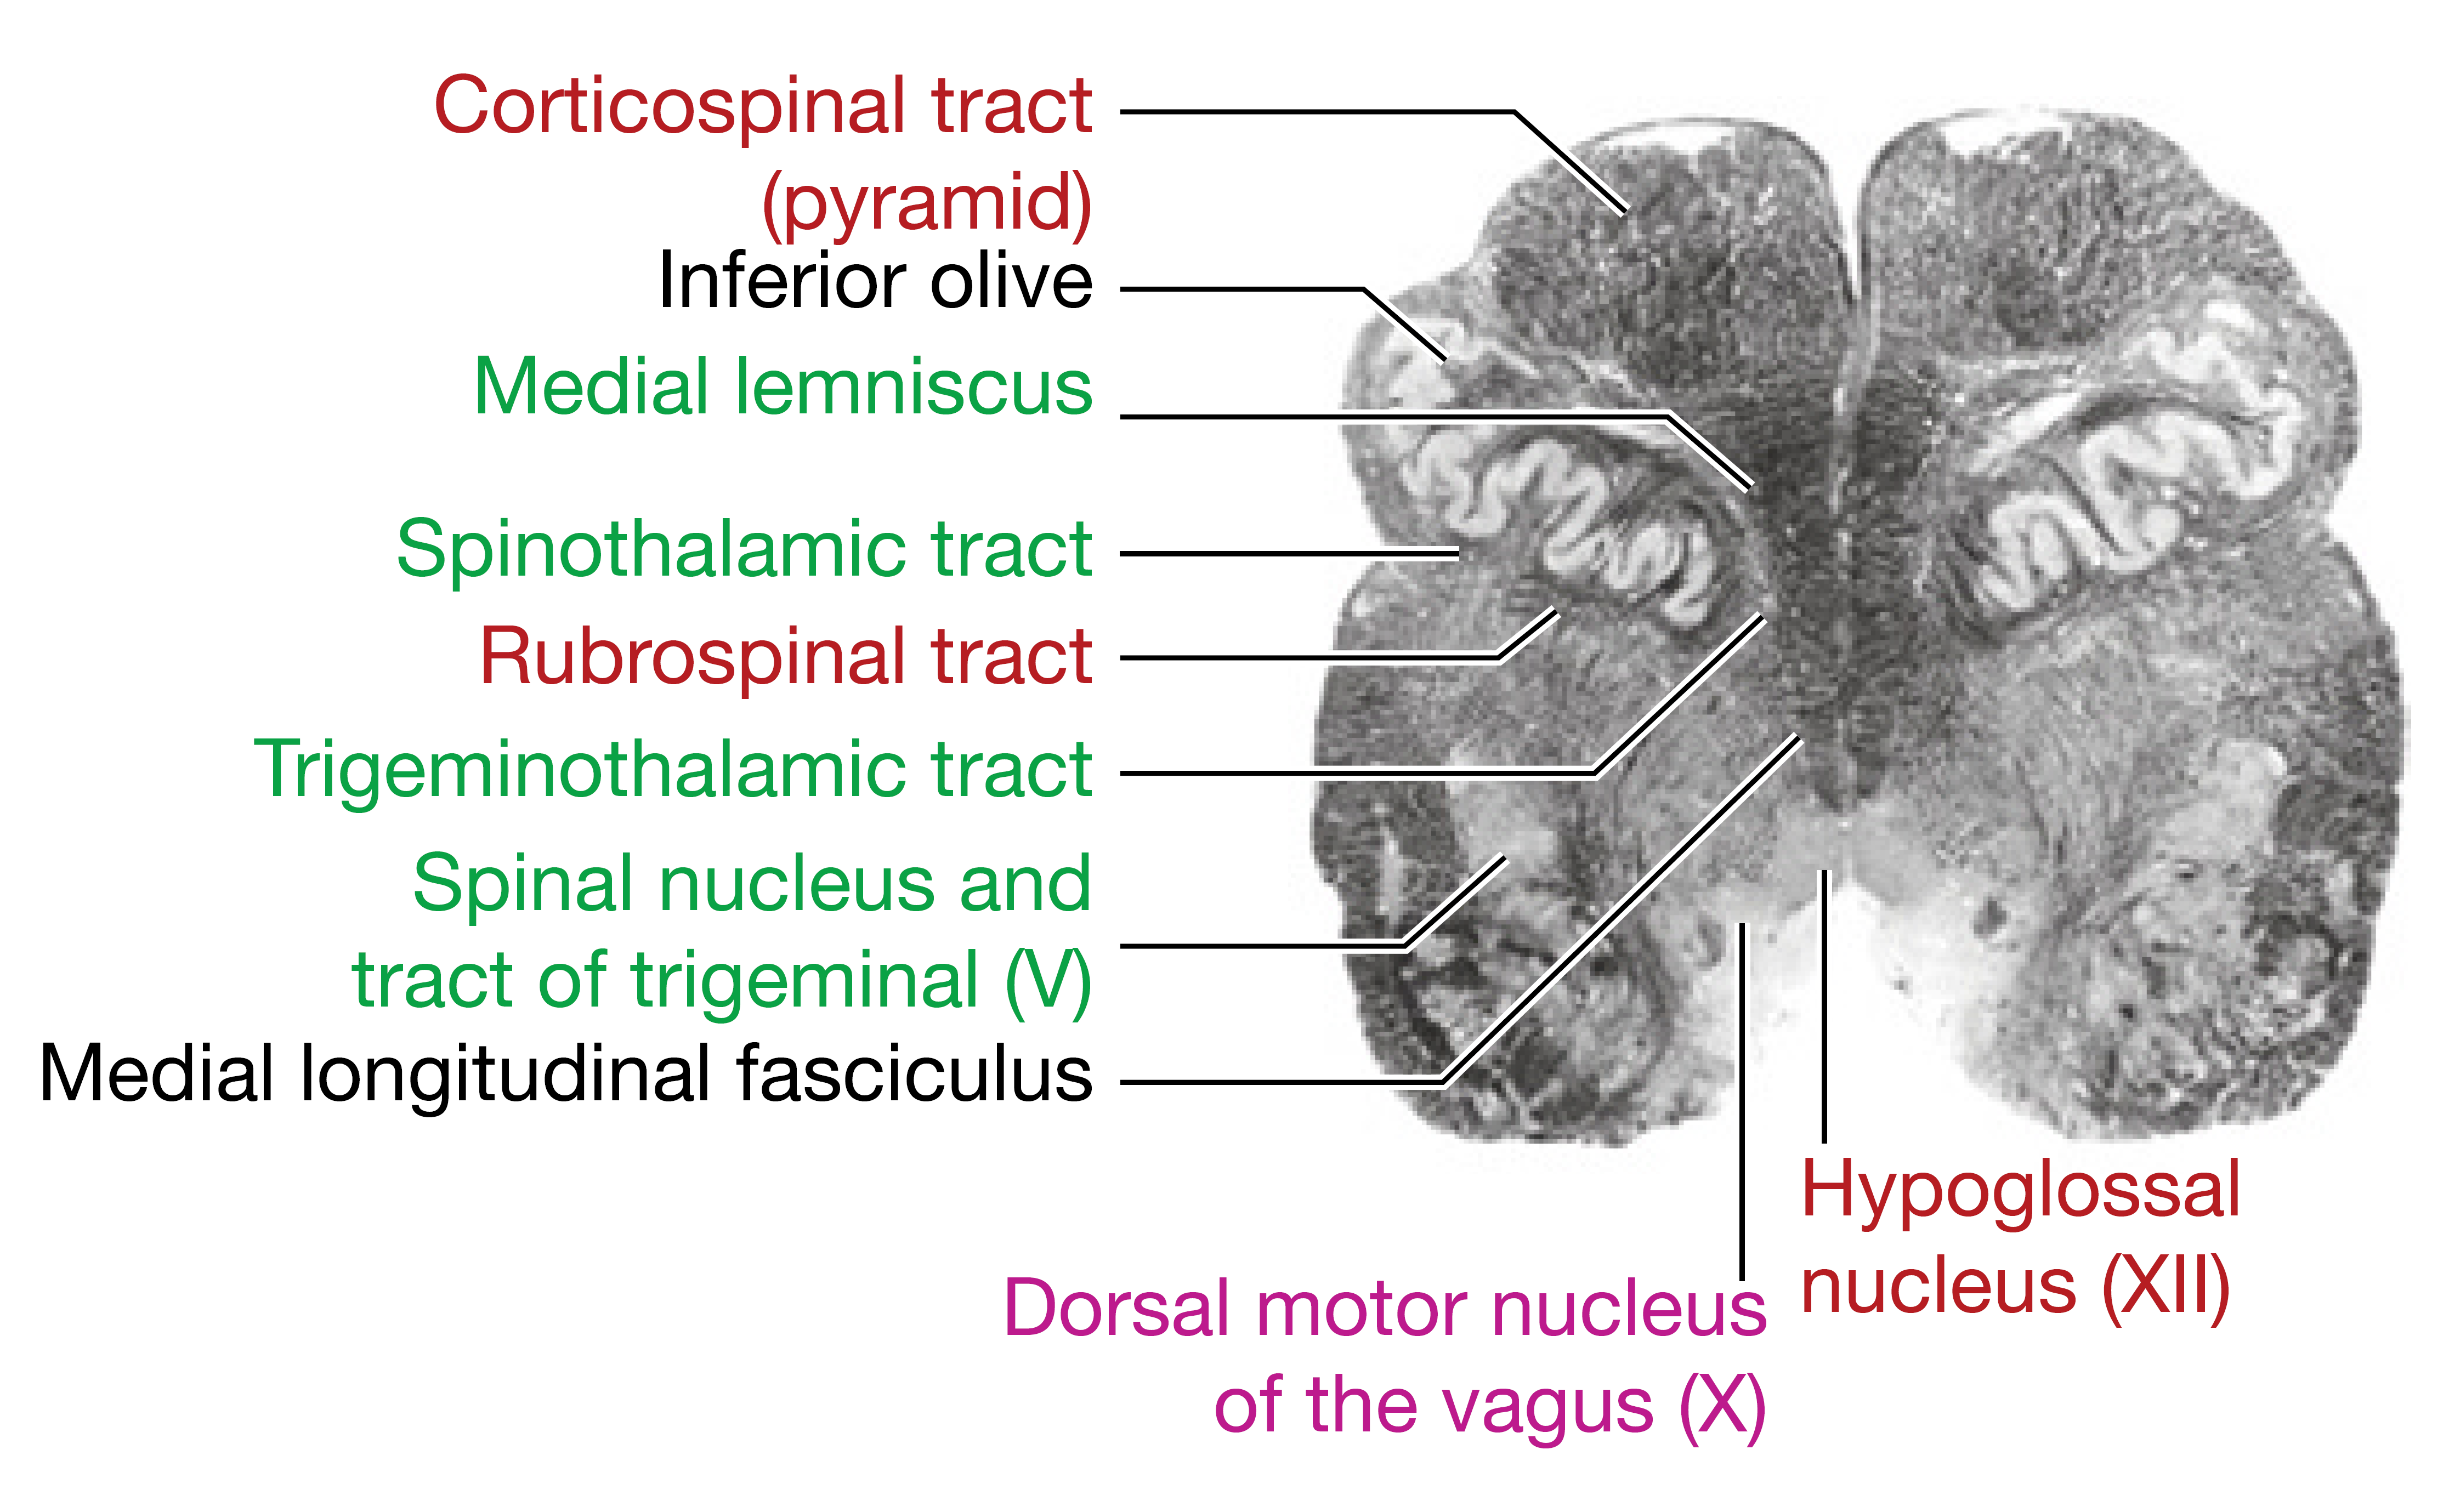
The medulla oblungata
Midbrain
Pons
Medulla
Oblungata
Sensory
Motor

